Slide 1
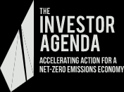
2021 Global Investor Statement to Governments on the Climate Crisis
Introducing the Investor Action Pack supporting investor advocacy
30 SEPTEMBER 2021
THE INVESTOR AGENDA
Notes:
Welcome, and thank you for joining this important discussion about what investors can do to encourage governments to implement the climate and financial policies needed ahead of the UN Climate Conference in Glasgow.
This presentation is brought to you by the founding partners of the Investor Agenda: IGCC, AIGCC, IIGCC, Ceres, CDP, Principles for Responsible Investment and UNEP Finance Initiative
The Investor Agenda provides global leadership on the climate crisis, focussing on accelerating investor action for a net-zero emissions economy
The collaboration brings together and coordinates a number of investor and finance sector initiatives on the climate crisis
You may be familiar with our work on Investor Climate Action Plans (or ICAPs), and hopefully engaging in this initiative.
The Investor Agenda’s other major policy initiative is the Global Investor Statement to Governments on the Climate Crisis.

Slide 2
Overview
01.
02.
03.
04.
05.
What the climate crisis means for investors.
The 2021 Global Investor Statement to Governments on the Climate Crisis.
The power of investor advocacy.
Advocacy tools in the Investor Action Pack.
Discussion (15 minutes).
30 SEPTEMBER 2021
THE INVESTOR AGENDA

Slide 3
What the climate crisis means for investors
30 SEPTEMBER 2021
THE INVESTOR AGENDA

Slide 4
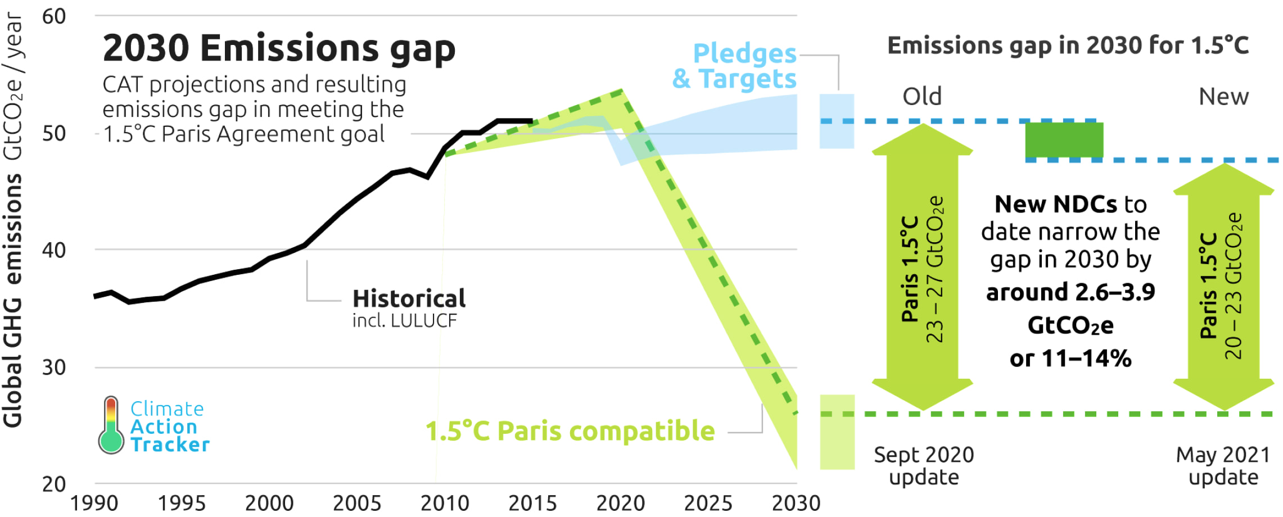
The urgency of action
Where we are:
1.1 degrees hotter.
Where we are headed:
2030: 1.5 degrees hotter 2100: 2.7 degrees hotter
Where we need to be:
2030: emissions 45 percent lower than in 2010 2050 or sooner: net zero emissions
https://climateactiontracker.org/publications/global-update-september-2021/
30 SEPTEMBER 2021
THE INVESTOR AGENDA
Notes:
The latest climate science tells us we are facing a climate ‘crisis’:
The Intergovernmental Panel on Climate Change released an alarming report in August which showed that the world is warming at a much faster rate than previously understood
The world is already 1.1 degrees hotter than pre-industrial levels, and we are seeing the devastating impacts: fires in Greece, California and Australia; hurricane Ida in the United States; floods in Germany and Belgium; bleaching of the Great Barrier Reef; and sea level rise worldwide
The world is rapidly approaching 1.5 degrees Celsius - at which point low lying countries, such as small island states in the Pacific, will not be able to survive
The world is currently on track to reach 1.5 degrees as soon as 2030, continuing to rise thereafter to about 2.7 degrees by the end of this century
The impacts of climate change will become more frequent, and more severe, bringing increasing physical risks to investors’ assets.
The UN’s latest synthesis of countries’ 2030 emissions reduction targets, released on 17 September, projects global emissions to be 16 per cent higher than 2010 levels in 2030.
The IPCC report tells us that for the world to remain below 1.5 degrees Celsius, global emissions in 2030 need to be 45 per cent lower than 2010 levels
And the world needs to reach net zero emissions before 2050.

Slide 5
This will require
trillions
30 SEPTEMBER 2021
THE INVESTOR AGENDA
Notes:
The scale of this challenge is enormous
It will take trillions of dollars of investment in adaptation, renewable energy and zero emissions infrastructure and technology
The private sector has a critical role to play in supporting this investment
Investors are a critical part of the solution.

Slide 6
The policy challenge
01.
02.
03.
04.
05.
Policy uncertainty
Weak targets
Ineffective policies
Financial barriers
Inadequate disclosure
30 SEPTEMBER 2021
THE INVESTOR AGENDA
Notes:
We know though, that policy settings need to be right for investors to channel the trillions of dollars needed to address the climate crisis
Investors need legislated policy signals to invest at scale in emerging technologies and major infrastructure, and coordinated whole-of-government policies to increase certainty around the investment environment
This includes short- and long-term emissions reduction targets that will keep global warming below 1.5 degrees, sector-level timetables for transiting, and policies that incentivise zero-emissions investment
Corporate climate risk disclosure also needs to be mandatory and consistent with the recommendations of the Task Force on Climate-Related Financial Disclosures
Financial markets can’t properly price and act on the physical and transitional risks of climate change without clear, consistent and comparable reporting from companies, investors, banks and insurers
Investors are facing regulatory complexity with the various voluntary and mandatory reporting frameworks around the world
It would be ideal if all countries were to implement consistent mandatory regimes in line with the TCFD.

Slide 7
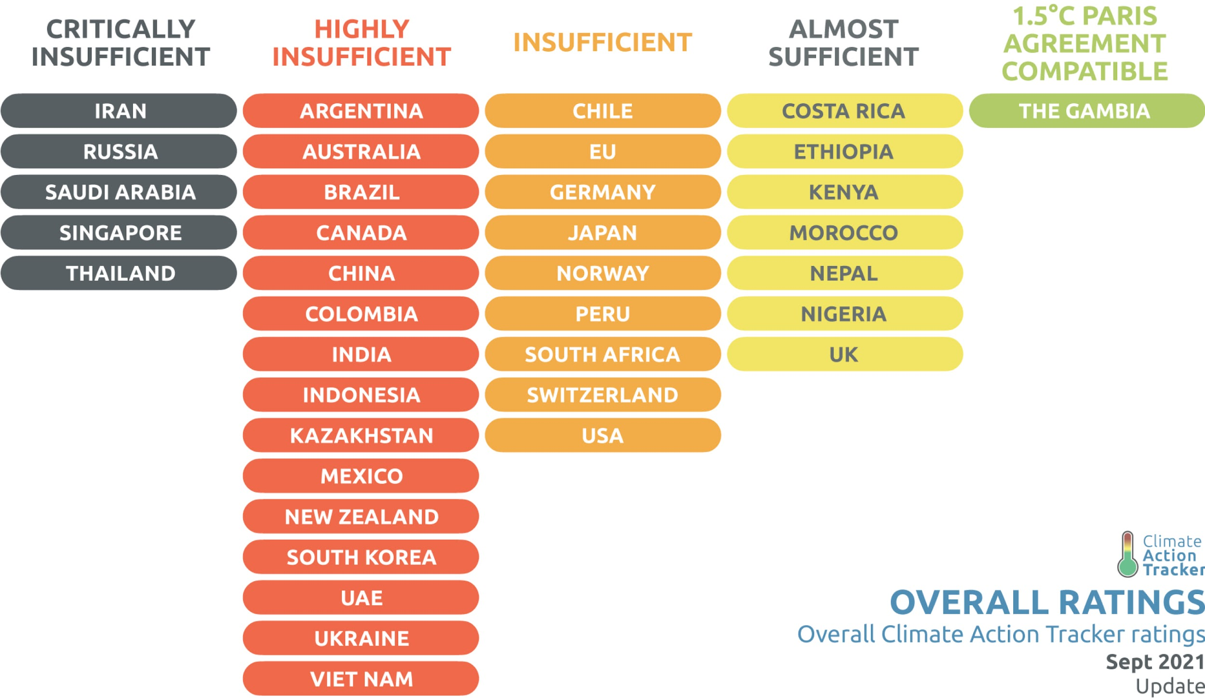
https://climateactiontracker.org/publications/global-update-september-2021/
30 SEPTEMBER 2021
THE INVESTOR AGENDA
Notes:
Unfortunately, in many countries, government policies and investments are not only insufficient, but actually acting as a roadblock.
Yes, there have been some positive developments, such as the significantly higher 2030 targets announced by the US, EU and Germany.
But according to Climate Action Tracker:
There is only one country in the world whose climate action is consistent with 1.5 degrees: the Gambia
The UK is the only G20 country whose 2030 target is considered 1.5˚C compatible. But its policies and international support don’t match
Australia, Brazil, Indonesia, Mexico, New Zealand, Russia, Singapore, Switzerland and Vietnam have all failed to lift their ambition at all ahead of Glasgow, submitting the same or even less ambitious 2030 targets than those they put forward in 2015
Many G20 countries’ 2030 targets or policies are consistent with over 3 and up to 4 degrees of warming: India, Brazil, Russia, Indonesia, Saudi Arabia, Mexico, South Korea, Argentina, Canada
Many G20 countries still have not committed to net zero emissions by mid-century: Australia, India, Russia, Indonesia, and Saudi Arabia
Looking at the progress of G20 countries on mandatory climate risk disclosure policies:
Only the UK and EU have implemented mandatory disclosure in line with the TCFD
India, Russia, Indonesia, Saudi Arabia, Argentina, South Korea and Mexico have no mandatory disclosure policies at all.
Governments urgently need to address these policy roadblocks if we are to have any chance of avoiding the worst effects of climate change.

Slide 8
Investors can help solve the policy challenge
30 SEPTEMBER 2021
THE INVESTOR AGENDA
Notes:
In 4 weeks’ time, world leaders will come together at the G20 Summit in Rome, followed by COP26 in Glasgow, where they will be expected to put their best foot forward in responding to the climate crisis. Especially the major emitters.
Businesses, investors and civil society need to put sustained pressure on governments in the next few weeks to make it politically untenable for world leaders to come to Glasgow without meaningful and ambitious climate policy commitments.

Slide 9
2. The 2021 Global Investor Statement to Governments on the Climate Crisis
30 SEPTEMBER 2021
THE INVESTOR AGENDA

Slide 10
Around 600 investors Over US$46 trillion 40 percent of global assets under management
30 SEPTEMBER 2021
THE INVESTOR AGENDA
Notes:
The Investor Agenda’s 2021 Global Investor Statement to Governments on the Climate Crisis is a powerful tool to help investors influence governments to make these policy changes.
The Statement has so far been signed by over 600 investors from around the world, collectively managing more than 46 trillion US dollars in assets
This is around 40 per cent of global assets under management
Getting over 600 investors of different sizes and from different regions to agree to a single policy statement to governments is no mean feat
It highlights that good climate policy is a priority for investors, no matter which part of the world they are from, and that policy change and action is needed urgently.

Slide 11
GIS Policy Recommendations
01.
02.
03.
04.
05.
Stronger 2030 targets in line with 1.5 degrees
Commitment to net zero emissions by mid century
Effective domestic policies and just transition plans
Complementary COVID-19 stimulus
Mandatory TCFD disclosure
30 SEPTEMBER 2021
THE INVESTOR AGENDA
Notes:
The Investor Agenda’s 2021 Global Investor Statement makes five clear policy asks of governments:
Strengthen 2030 emissions targets to align with 1.5 degrees or less of warming
Commit to net-zero emissions by 2050 or sooner
Implement effective domestic emissions reduction policies for emissions-intensive sectors, and just transition plans for affected workers and communities
Invest in complementary COVID-19 economic recovery stimulus measures
Implement mandatory climate risk disclosure in line with the TCFD.

Slide 12
Join the
statement
30 SEPTEMBER 2021
THE INVESTOR AGENDA
Notes:
I congratulate everyone that has signed the Statement and encourage others that have yet to do so to reach out to discuss any hesitations you may have.
The Statement remains open to additional signatories until 20 October, before the statement and final list of signatories is showcased at COP26.

Slide 13
3. The Power of Investor Advocacy
30 SEPT 2021
THE INVESTOR AGENDA

Slide 14
COP26 in Glasgow:
a key moment for global climate action
30 SEPT 2021
THE INVESTOR AGENDA
Notes:
Governments need to be put under sustained pressure in the leadup to Glasgow to address policy roadblocks
Glasgow will be a key political moment when the media and voters will be paying attention to what governments are doing to address the climate crisis and ensure that climate risk is appropriately managed
With countries being compared to one another, there will be peer pressure on countries to put their best foot forward
Glasgow is therefore an opportunity to secure the policies needed for investors to channel trillions of dollars for a sustainable future.
UN Climate Conferences are not just for politicians and government officials to get together and negotiate deals - there is a significant non-government aspect
Hundreds of non-government stakeholders attend the climate conferences as observers
Non-government stakeholders can help build positive momentum behind the scenes to the negotiations
They have opportunities to present their efforts in side events, to see up close what is happening in the negotiations, and to engage with politicians to get better outcomes
The Investor Agenda’s global investor statements on climate have attracted high-level attention in the past. For example the UN Secretary General highlighted the 2019 Global Investor Statement on Climate twice at the 2019 UN General Assembly, in an op-ed and in his closing remarks at COP25 in Madrid.
At the COP in Glasgow this year, there will be opportunities to participate virtually due to the ‘hybrid’ nature of the conference being partially in person and partially online
The Investor Agenda will host a side event on Finance Day, the 3rd of November.
This will be a key opportunity to highlight the 2021 Global Investor Statement and its policy recommendations.

Slide 15
Investors can be powerful influencers of government policy
Over 600 potential ambassadors for the 2021 Global Investor Statement to Governments on the Climate Crisis
30 SEPT 2021
30 SEPT 2021
THE INVESTOR
THE INVESTOR AGENDA
Notes:
In the leadup to Glasgow, it is not just for NGOs and civil society to pressure governments to step up their efforts on climate
Investors can arguably have a much more powerful influence
After all, it’s investors that have the finance needed to make the low emissions transition possible
It is one thing for us at AIGCC and IGCC to advocate for better government policy. It is quite another to have investors themselves putting pressure on governments.
You’ve signed the Investor Agenda’s 2021 Global Investor Statement to Governments on the Climate Crisis; now we are keen to see it used as a launching pad for investors to go out and advocate for its recommendations
Imagine the impact if the hundreds of signatories to the 2021 Global Investor Statement were actively involved in its promotion and advocacy.
There are various ways that investors could promote the 2021 Global Investor Statement on Climate and advocate for its recommendations:
Investors could promote their participation in the Statement on social media, their website and in their member newsletter
Investors could actively pursue meetings with policy-makers and the media to push governments to implement its policy recommendations
Investors could underline their commitment to the Statement by committing to net-zero emissions by 2050 or sooner, reporting on climate risk in line with the TCFD guidelines, and developing comprehensive Investor Climate Action Plans.
If you are keen to be involved in this effort, we have a useful toolkit to make it easy for you.

Slide 16
4. Advocacy tools in the Investor Action Pack
30 SEPT 2021
THE INVESTOR AGENDA

Slide 17
Request your Investor Action Pack
info@theinvestoragenda.org
30 SEPT 2021
THE INVESTOR AGENDA
Notes:
Hopefully you will have already received your Investor Action Pack and social media assets by email
If not you can email us at info@theinvestoragenda.org to request them.

Slide 18
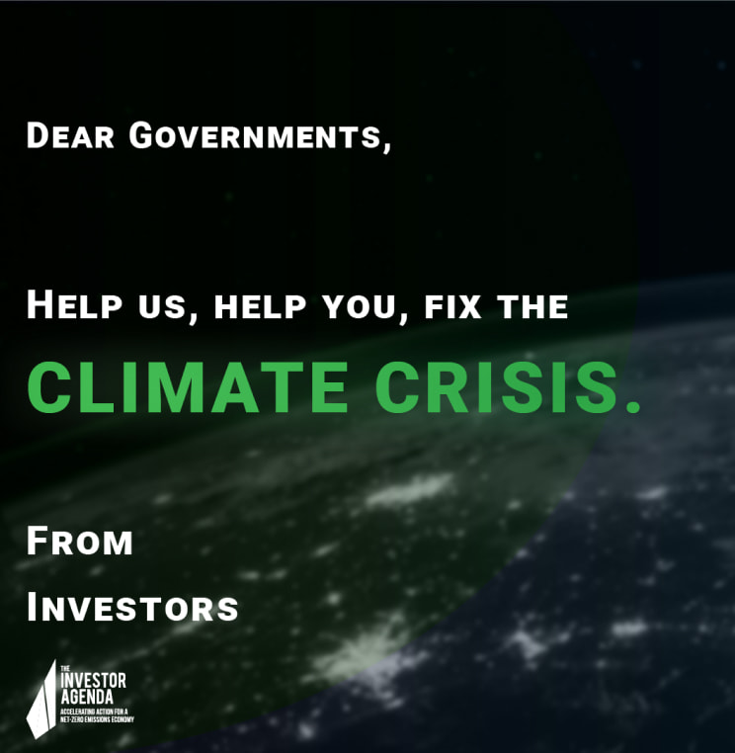
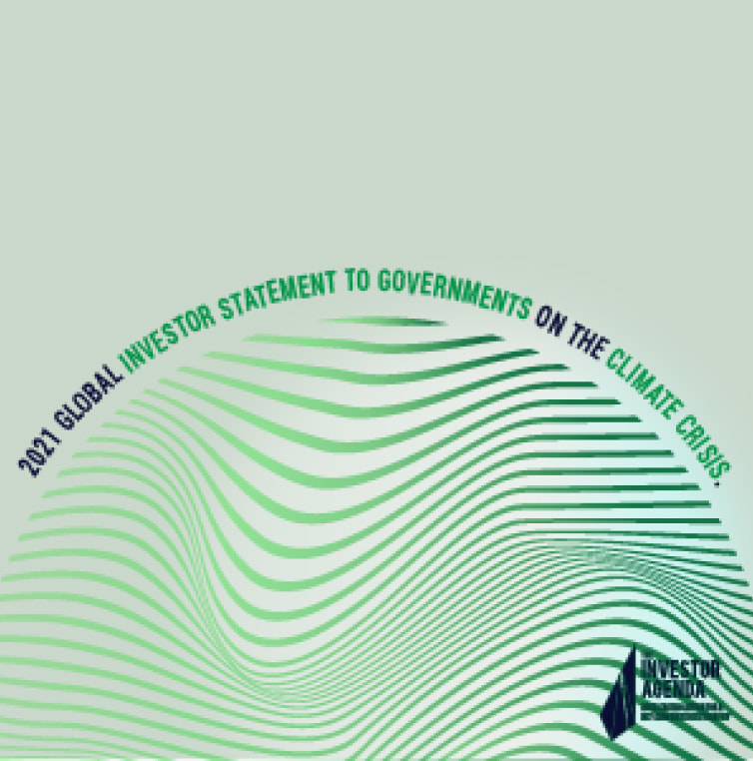
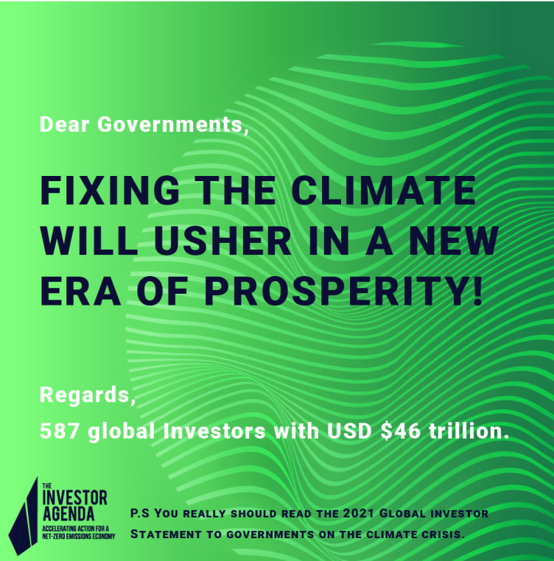
The Investor Action Pack
30 SEPT 2021
THE INVESTOR AGENDA
Notes:
The Investor Action Pack includes:
A template media release which you could publish on your company website to highlight that you are one of more than 600 investors that have signed the 2021 Global Investor Statement on Climate
A template letter or email to policy-makers, encouraging them to respond to the Statement’s recommendations in the policies they bring to Glasgow
Talking points which you could use when meeting with policy-makers and the media; and
Social media assets to promote the Statement and its recommendations on Twitter, LinkedIn, Instagram and Facebook.

Slide 19
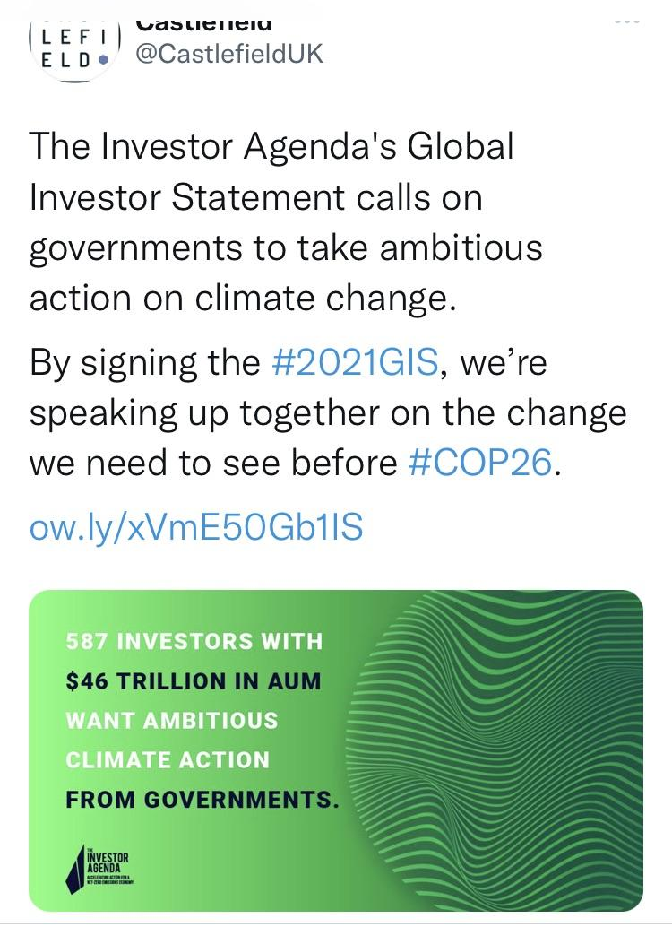
30 SEPT 2021
THE INVESTOR AGENDA
Notes:
We are really pleased to see that some investors have already been using these tools
The Investor Agenda and its founding partners aim to publicly highlight the advocacy efforts of investors that are encouraging governments to implement the Global Investor Statement’s recommendations.

Slide 20
Thank You
www.theinvestoragenda.org info@theinvestoragenda.org
30 SEPTEMBER 2021
THE INVESTOR AGENDA

